Slide 1
Troublesome Tanks.
Simon Grey s.grey@hull.ac.uk
David Parker d.j.parker@hull.ac.uk
Computer Science
School of Engineering and Computer Science
University of Hull, U.K.

Slide 2
Roadmap
Creativity from Constraints
Form Groups & Play Troublesome Tanks
Discussion of strategy in groups
Play through again
Discussion of improvements as groups
Report Back & Questions

Slide 3
Creativity from Constraints

Slide 4
Games at Hull
Highly respected masters
1st Course to be accredited by skillset
Excellent track record for employment in Games industry
Lecturers are frustrated games developers

Slide 5
Game Jams
October 2010 “XNA Mad Game Development”
8 Page Feature in 360 Magazine
Everyone made “Destruction Golf”
It was a great first game jam!
but output lacked diversity
it was easy to make negative comparisons between teams

Slide 6
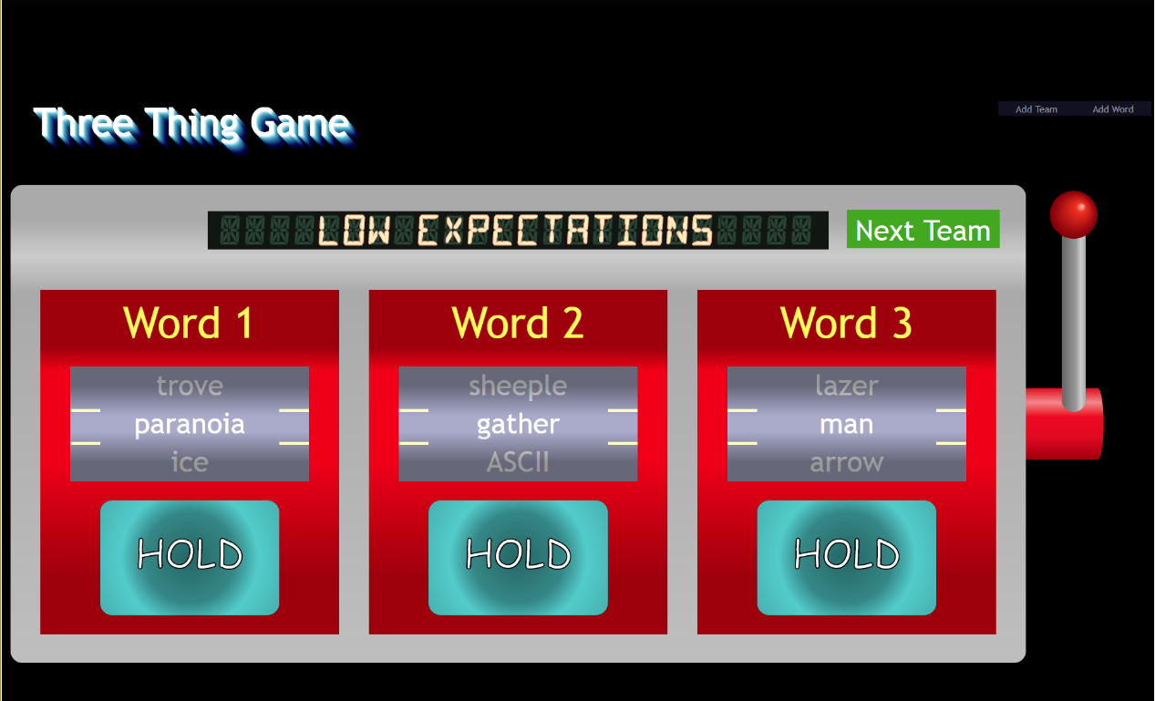
Three Thing Game
Each team gets three “things” to base their game around
This diversity encourages creativity
Try to give some agency to “thing” selection
Encourage students to integrate “things” as core mechanics

Slide 7

Spooky Elephant est. 2012(ish)
We found teams were getting better and better to the point that they were publishing games
Spooky Elephant is a brand that we develop games under

Slide 8
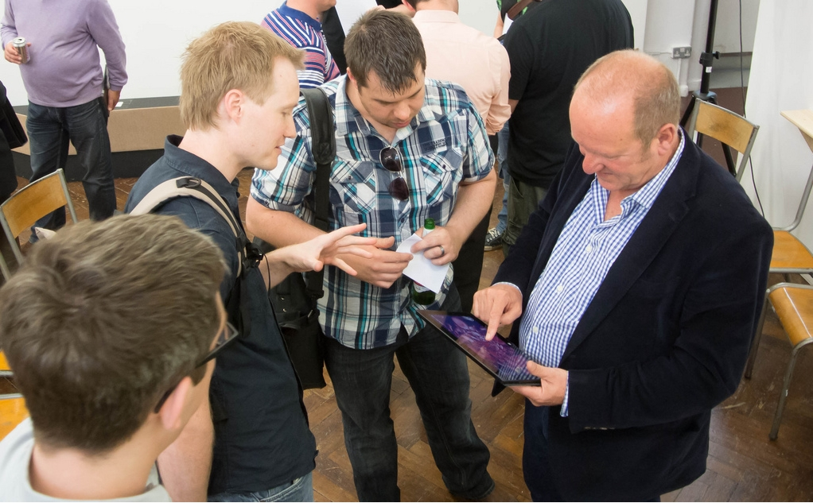
Global Game Jam 2013: Super Heartotron
Theme “The sound of a heart beat”
A creative solution to create an international theme
Used Oximeter to measure players heartbeat and use it as a mechanic in the game
Released an altered version to the Windows Store

Slide 9
Global Game Jam 2014: Disruption
Theme: “We don’t see things as they are, we see them as we are”
Diversifier: Hackontroller. The game must use a custom controller invented by the team, or use an existing controller in unconventional manner.
In 48 hours created two “symbiotic” games and a custom controller to play them

Slide 10
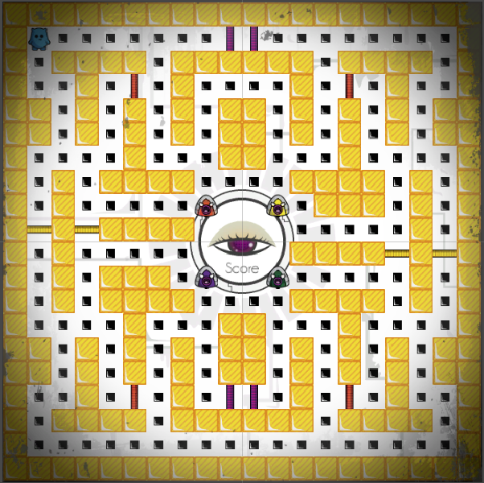
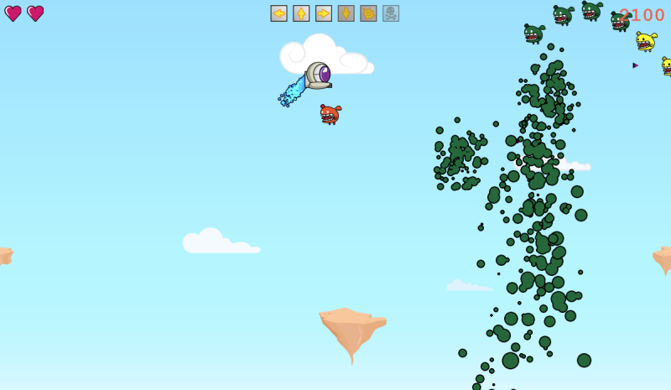
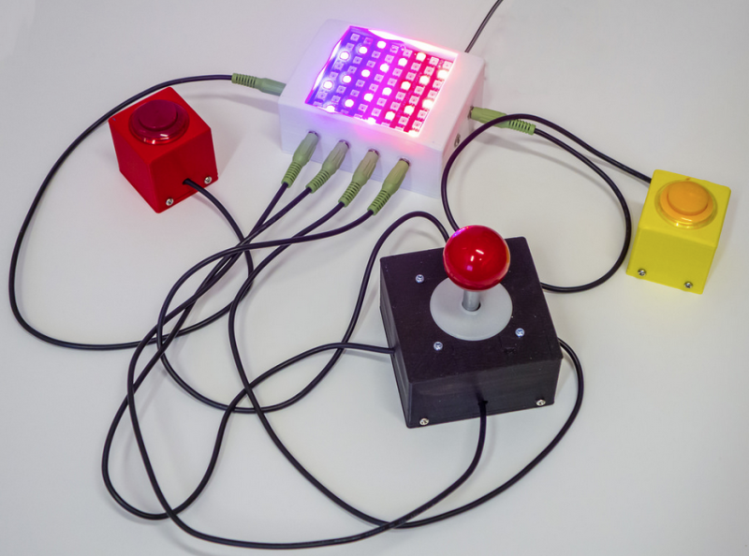
Global Game Jam 2014: Disruption

Slide 11
Alt Dev Ctrl
Didn’t quite work – was awarded “most ambituous failure” at GGJ 2014
Made the controller work
Exhibited in the alternative controller exhibition at GDC 2016, San Francisco
Lots of good feedback

Slide 12
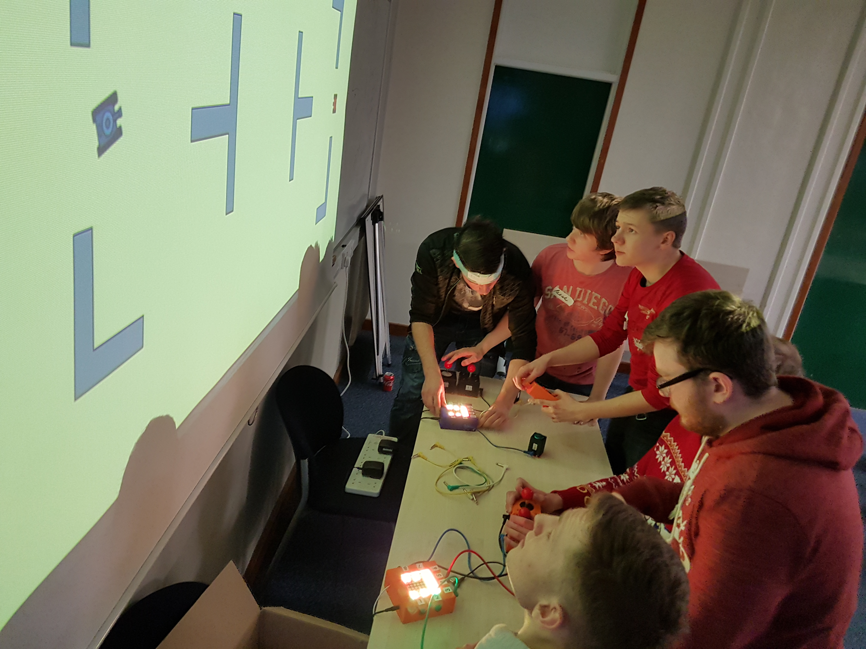
Three Thing Game 2017
Some Trouble Tanks
Repurposed the controllers
Proof of concept seemed to work well

Slide 13
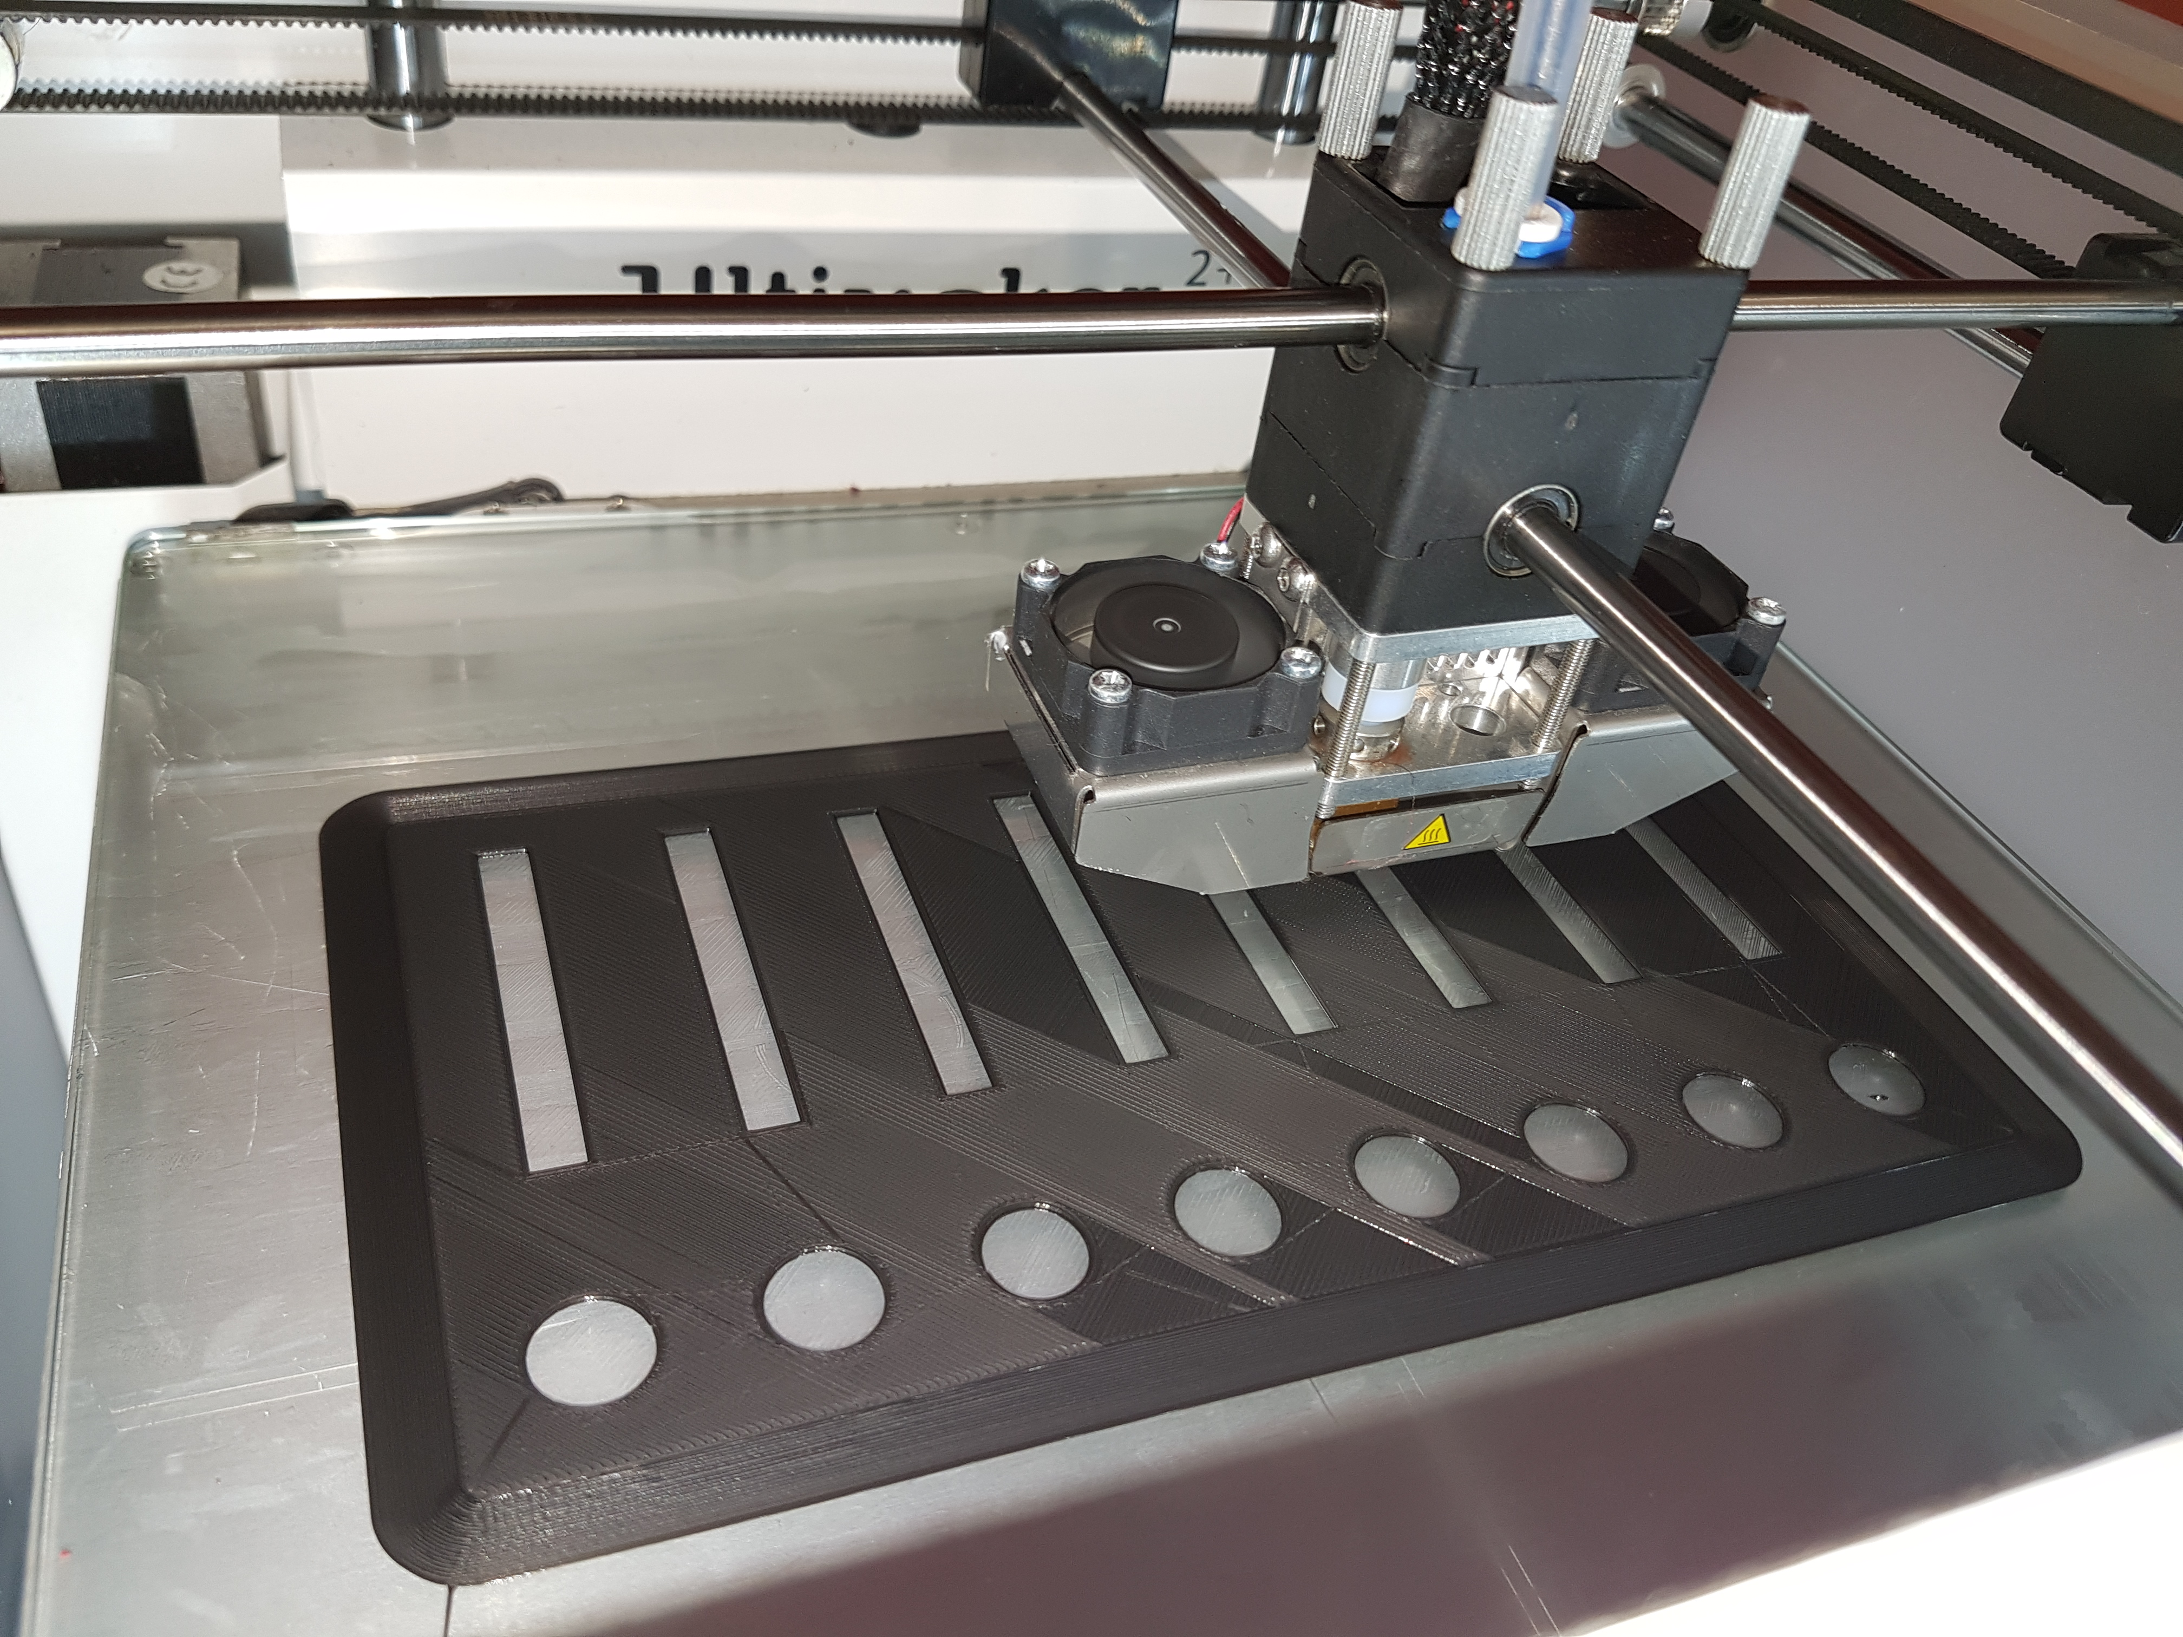
Controller Information
Runs from an Arduino board
Uses resistances to identify control parts
One controller takes around 7-11 hours to print
Fab lab

Slide 14
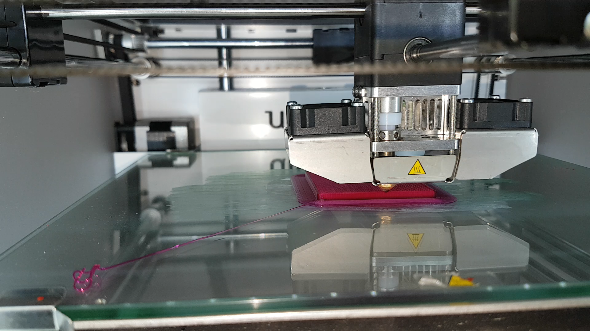

Slide 15
Rule of Three
The Fates
(The) Star Wars Trilogy
Freud’s Personalities
Ear Bones
Bronte Sisters
Columbus’ Ships
A 3 Piece Suit
Destiny’s Child
The Bee Gees
Primary Colour
Gryffindor Trio
Indiana Jones Trilogy

Slide 16
Troublesome Tanks
Ideally work in teams of 3
One drives tank tracks forwards and backwards
One rotates the turret and fires the cannon
One keeps all the other controls powered up
Arena based combat

Slide 17
A question for you
What is it good for?
Recruitment tool?
Ice breaker?
Team building tool?
What else?

Slide 18
Play time!
15 minutes

Slide 19
Regroup and Strategise!
10 minutes

Slide 20
Back to the front!
15 minutes

Slide 21
Survey the battlefield!
15 minutes

Slide 22
Share!
15 minutes

Slide 23
Questions?

